Slide 1
2025
Graduate School
of Business Engineering
Ivanov
Ivan
student of group 0123456789
TOPIC
TOPIC OF THE FINAL QUALIFYING WORK

Slide 2
Graduate School
of Business Engineering
2025
TOPIC:
«TOPIC OF THE FINAL QUALIFYING WORK»
Institute of Industrial Management, Economics and Trade
Student of group 0123456789
Ivanov Ivan
УПРАВЛЕНИЕ ПО СВЯЗЯМ С ОБЩЕСТВЕННОСТЬЮ СПБПУ

Slide 3
Tasks:
Define…;
Analyze…;
Reveal….;
Develop…;
Build….;
And so on.
TARGET
DESCRIPTION OF THE PURPOSE OF THE FINAL QUALIFICATION WORK

Slide 4
Text
Technology | Patents 2003-2024 | Contracts 2018-2024
Additive technologies | 432 | 7 259
New materials and substances | 147 | 5 474
Digital twins | 74 | 1071
Microelectronics | 542 | 786
AI & ML & Big Data | 54 | 443
5G communication (wireless communication) | 17 | 278
Genetic technologies** | 75 | 182
Photonics | 24 | 175
Quantum technologies | 54 | 159
Industrial robots | 74 | 113
Drones | 45 | 74
Cloud technologies | 4 | 49
Energy storage systems | 75 | 21
Internet of Things (IoT) | 17 | 29
New and portable energy sources | - | 9
305
Number of patents for inventions, utility models and software
1140
Contracts for 5 years with technology readiness level
3305
Number of patents for inventions, utility models and software

Slide 5
Text:
1. Text.
2. Text.

Slide 6
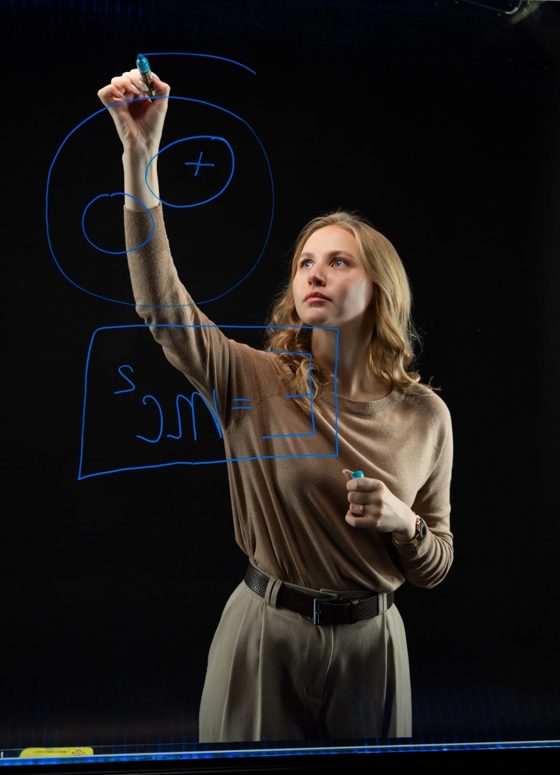
Text
Text explanatory information

Slide 7
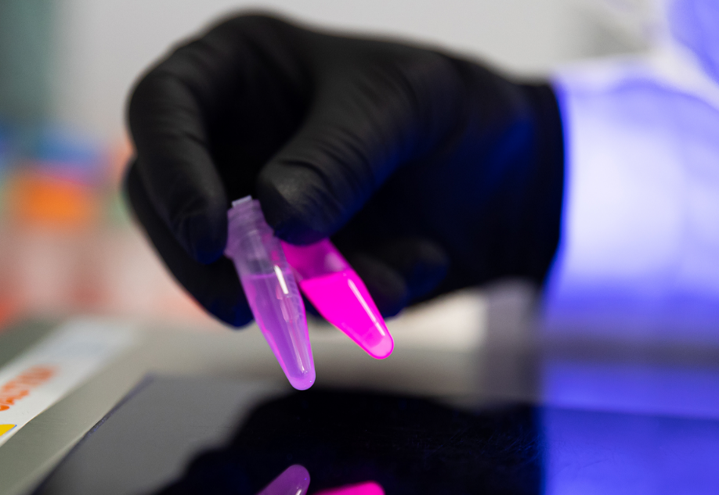
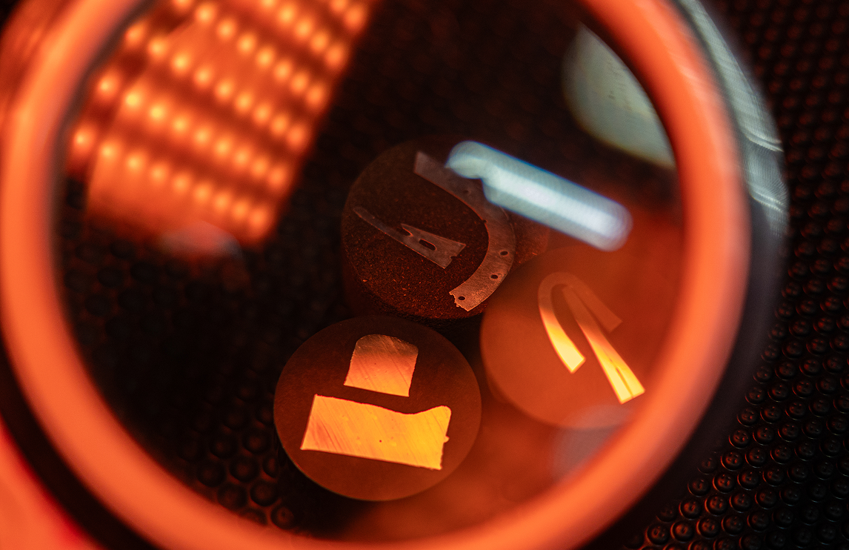
Text
Study of the properties of microplastics
Study of microplastic properties and search for patterns
Study of microplastic properties and search for patterns
The main logo of the university consists of a sign and an inscription. The sign is a stylized image of the Greek letter (Pi), enclosed in a rounded green field. The name and additional inscription are located next to the sign.
The main logo of the university consists of a sign and an inscription. The sign is a stylized image of the Greek letter (Pi), enclosed in a rounded green field. The name and additional inscription are located next to the sign.
The main logo of the university consists of a sign and an inscription. The sign is a stylized image of the Greek letter (Pi), enclosed in a rounded green field. The name and additional inscription are located next to the sign.

Slide 8
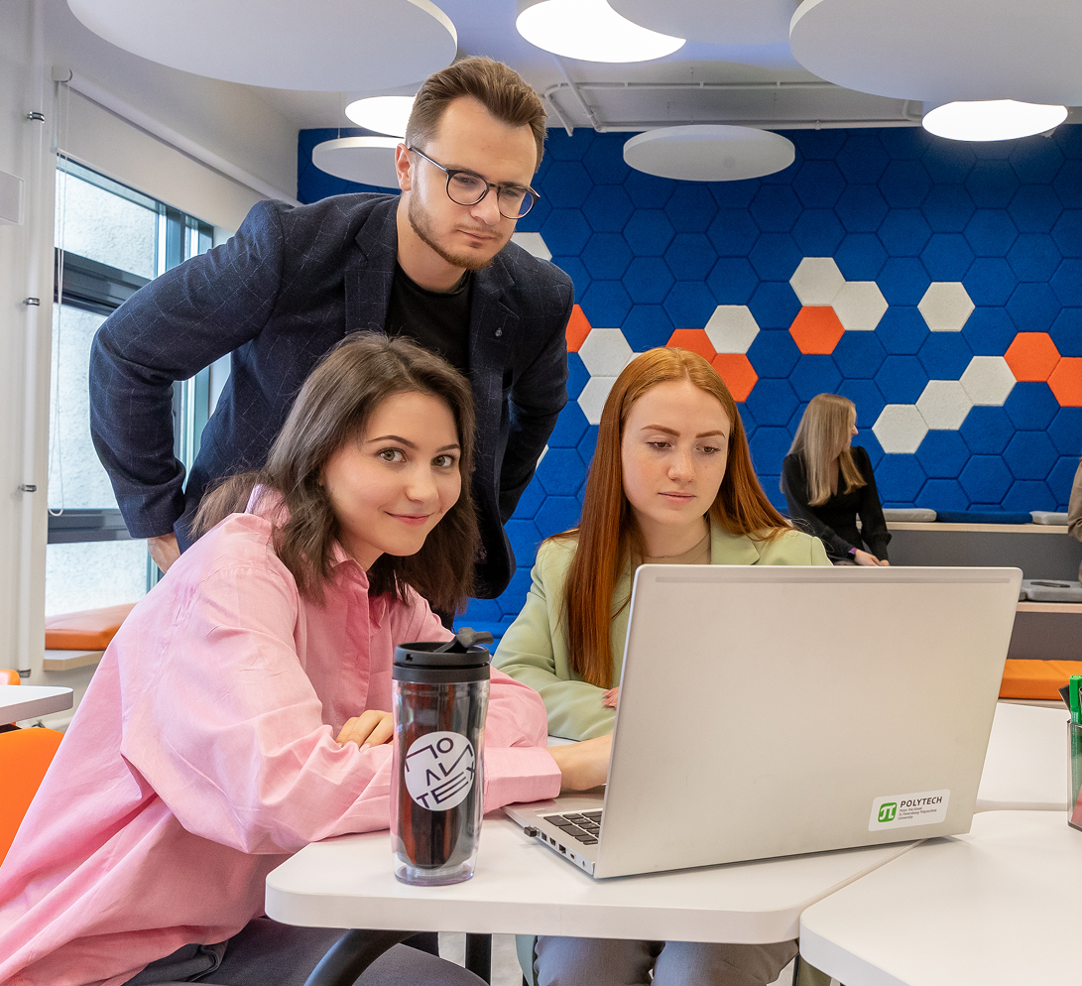
Text

Slide 9
Text

Slide 10
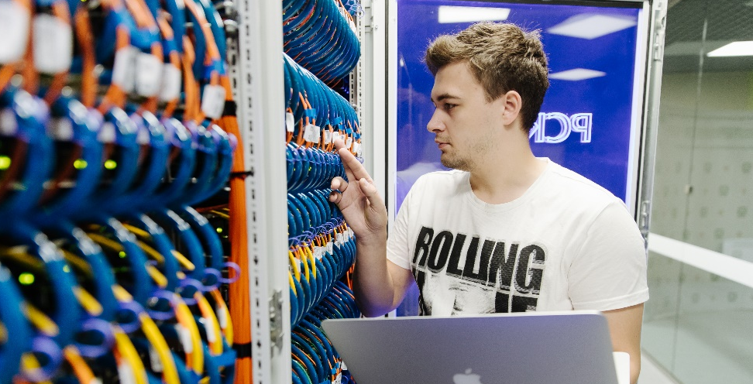
Text
Leading positions in the Russian and world markets in various segments
3D Printing and Additive Manufacturing
Technologies
Functional and Composite Materials
Development
Energy Efficiency and Renewable Energy
Microelectronics and Photonics
Space Equipment and Systems
Virtual Simulators and Digital Twins
High-Performance Computing
Big Data Processing.
154
Research workers
60
Dissertation councils
154
Postgraduate students
60
Research and educational laboratories
Research centers and scientific and technological complexes
Engineering and testing centers
Including 30 in the Advanced Engineering School
5
15
400
1500
ACADEMICIAN OF THE RAS
CORRESPONDENTS OF THE RAS
DOCTORS OF SCIENCE
CANDIDATES OF SCIENCE

Slide 11
THANK YOU FOR YOUR ATTENTION!
Graduate School
of Business Engineering
Ivanov Ivan
student of group 0123456789

Slide 12
THANK YOU FOR YOUR ATTENTION!
Graduate School
of Business Engineering
Ivanov Ivan
student of group 0123456789

